Slide 1
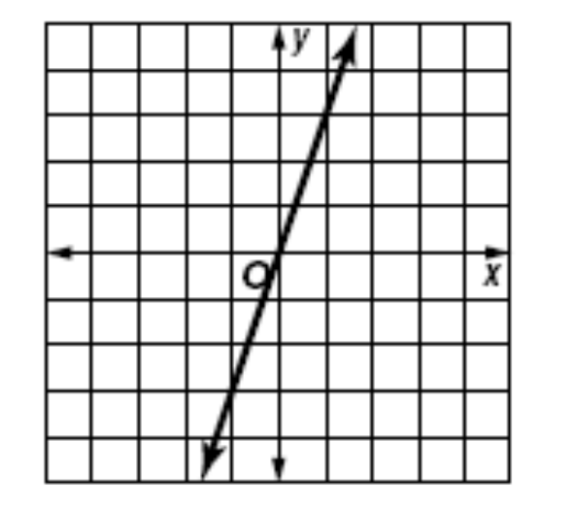
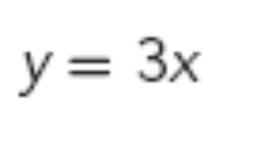
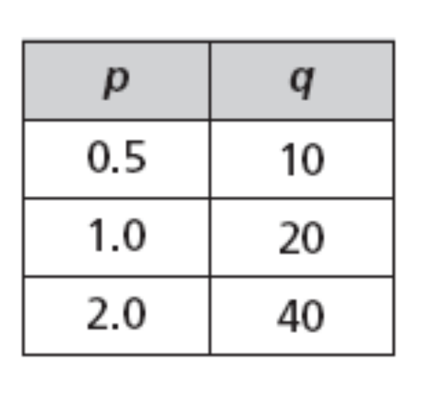
What do all three of these have in common?

Slide 2
11.3 Direct and Inverse Variation
Direct Variation
The following statements are equivalent:
y varies directly as x.
y is directly proportional to x.
y = kx for some nonzero constant k.
k is the constant of variation or the constant of proportionality

Slide 3
11.3 Direct and Inverse Variation
If y varies directly as x, then y = kx.
This looks similar to function form y = mx + b without the b
So if x = 2 and y = 10
Therefore, by substitution 10 = k(2).
What is the value of k? 10 = 2k
10 = 2k
5 = k

Slide 4
11.3 Direct and Inverse Variation
y = kx
can be rearranged to get k by itself
y = kx
÷x ÷x
y ÷x = k
or
k= y/x
So our two formulas for Direct Variation are
y=kx and k=y/x

Slide 5
Direct Variation in Function Tables
Direct Variation Formulas:
y= kx or k= y/x
y= kx
Since we multiply x by five in each set, the constant (k) is 5.
k= y/x
Or you can think of it as y divided by x is K.
This is a Direct Variation.
x y
2 10
4 20
6 30

Slide 6
Direct Variation in Function Tables
x y
2 1
4 2
6 3
y= kx or k=y/x
Is this a direct variation?
What is K?
K= ½ which is similar to divide by 2.

Slide 7
Direct Variation in Function Tables
x y
-2 -4.2
-1 -2.1
0 0
2 4.2
y= kx or k=y/x
Is this a direct variation?
What is K?
K= 2.1

Slide 8
Direct Variation in Function Tables
x y
2 6.6
4 13.2
6 19.8
y= kx or k=y/x
Is this a direct variation?
What is K?
K= 3.3

Slide 9
Direct Variation in Function Tables
x y
2 -6.2
4 -12.4
7 -21.5
y= kx or k=y/x
Is this a direct variation?
No, K was different for the last set.

Slide 10
11.3 Direct and Inverse Variation
Direct variations should
graph a straight line
Through the origin.
15
y = kx
10
y = 2x
5
2 = y/x
0
0
5
10
15
20

Slide 11
Direct Variation
How do you recognize direct variation from a table?
How do you recognize direct variation from a graph
How do you recognize direct variation from an equation?

Slide 12
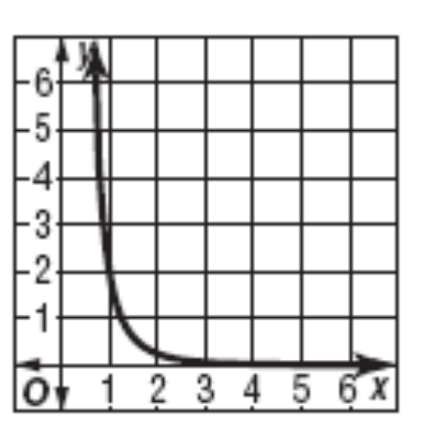
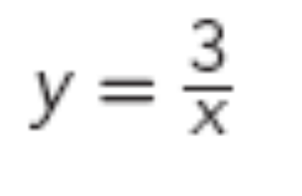
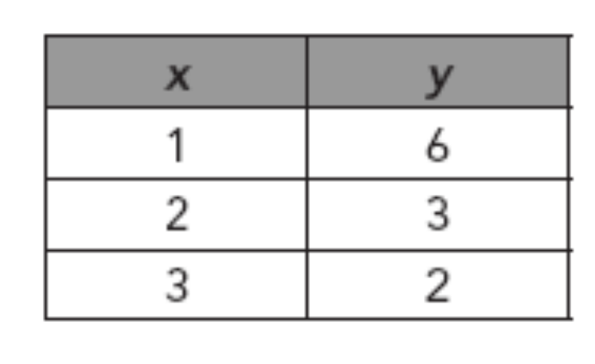
What do all three of these have in common?

Slide 13
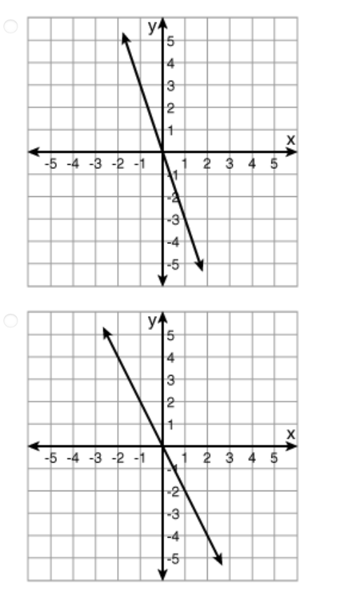
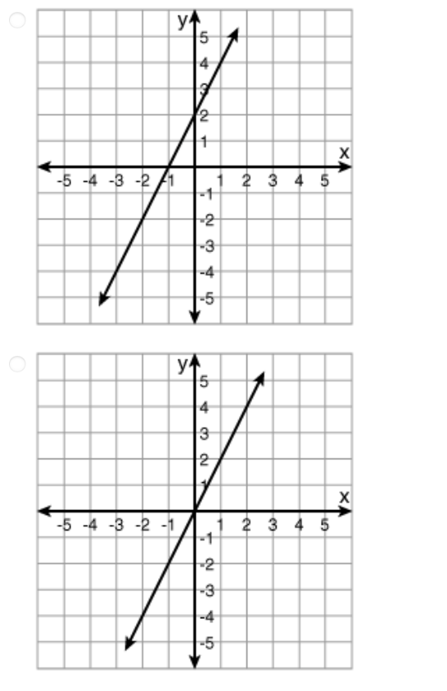

Slide 14
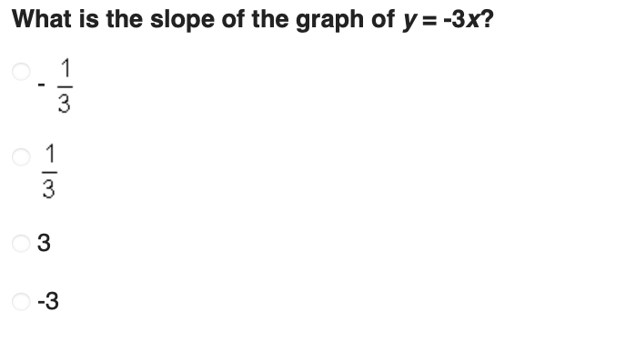

Slide 15
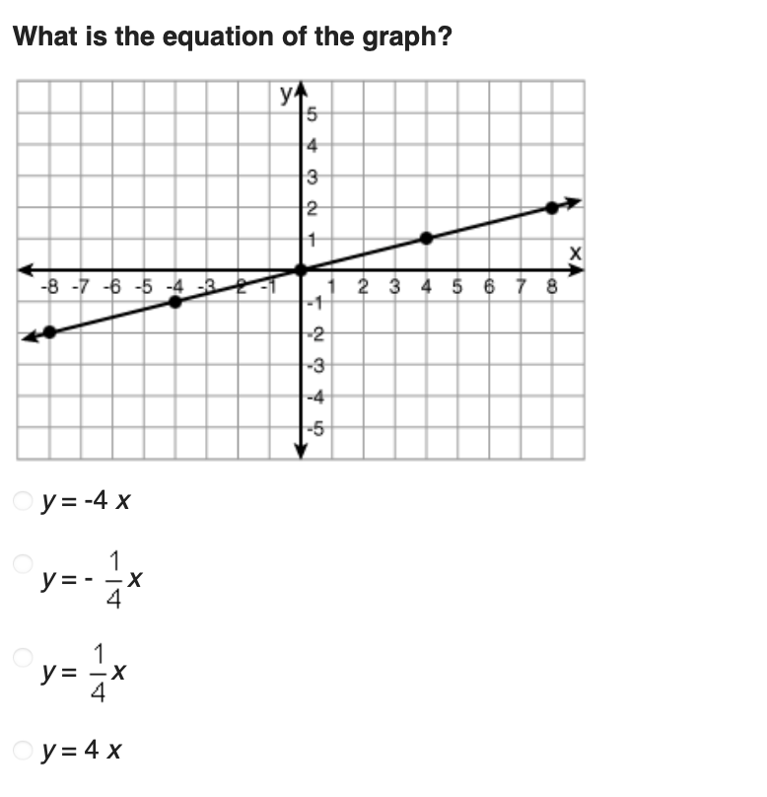

Slide 16
